Slide 1
Chapter 1. GIS Data Concepts
Gervais W Tabopda, PhD
School of City and Regional Planning
Notes:
James Ellroy, April 12, 2025, on French Television: “Geography is Destiny”.
The phrase "Geography is Destiny" is not an epigraph in one of James Ellroy's novels, but it is a concept that he frequently uses and associates with his writing, according to an essay by Dr. Alex Pavey. Ellroy himself has used the phrase in his own works and spoken about it in interviews. While the epigraph appears in Iain Sinclair's "Hackney, That Rose-Red Empire," Ellroy is often credited with its association, notes Dr. Pavey. He has used the phrase to describe how geography can influence the actions and lives of people, as well as the fictional world he creates in his books.
Emily Orminski, June 30, 2021: Your Zip Code is More Important than Your Genetic Code

Slide 2
Course Objectives
Understanding how GIS data represent real-world features
Knowing fundamental differences between the raster and vector data models
Using and discussing map scales and source scales
Recognizing local and Internet sources of GIS data
Cultivating awareness of the types of shortcomings associated with GIS data
Learning to correctly cite data sets on a map or in a report
Learning the basics of the ArcGIS Pro interface and viewing map data

Slide 3
GIS as a Database
GIS does not save information as maps or pictures
GIS holds information in a database, but the information has a spatial context
To go beyond making pretty pictures, you need to know:
1) What it is
2) Where it is
3) How it relates to other features
Notes:
A geographic information system (GIS) provides data structures and capabilities for storing,
analyzing, managing, and publishing map data using a computer.

Slide 4
Organization of GIS Data
▪ Objects and Fields
▪ Objects are spatial entities like lines, points, and polygons
▪ Fields are attributes describing these entities
▪ Vector vs. raster data
▪ Vector Data uses geometry to specify the size and shape of the object
▪ Raster Data uses “pixels” or grids arranged in a two-dimensional array that specifies the location of each pixel

Slide 5
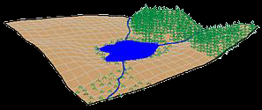
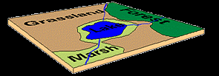
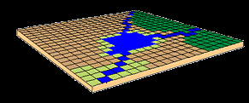
Vector and Raster Representation
In this example, our landscape consists of rolling hills, grassland, lake, rivers, forest and marshland.
VECTOR DATA
In the Vector Data Model, features on the earth are represented as points, lines/routes, and polygons/regions
RASTER DATA
In the Raster Data Model, land cover is represented as single square cells containing a value corresponding to its land cover type.
Copyright © 2013 by Maribeth H. Price

Slide 6
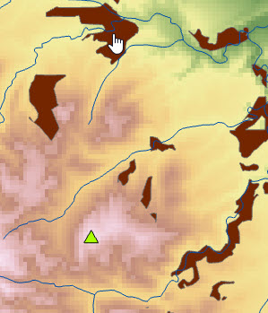
Types of map data
Discrete objects exist in a defined location/space
Lookout tower (point).
Stream (line).
Snail habitat (polygon).
Continuous data exist everywhere
Elevation (raster).
Source: USGS

Slide 7
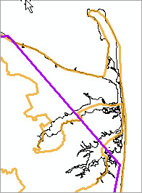
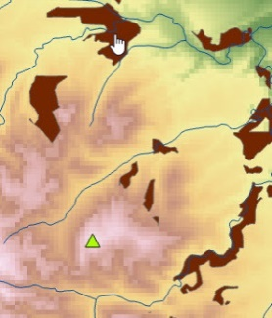
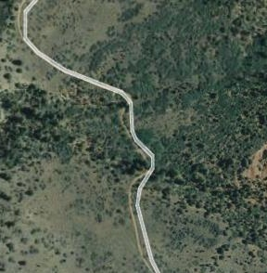
GIS data models
The vector model is best for discrete data
state boundaries.
streams.
snail habitat.
The raster model is used for imagery and is best for continuous data
elevation.
aerial photography.
Source: Esri
Source: USGS
Source: Google Earth and Tele Atlas

Slide 8
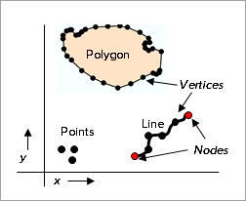
Vector data model
The vector data model is best for discrete data
Features are stored map objects
Points, lines, polygons.
A feature class is a collection of similar features stored together, like states or rivers

Slide 9
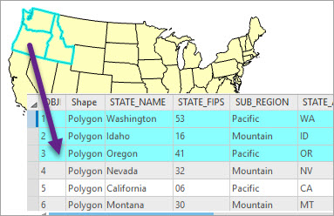
Attribute tables
Features are linked to tables containing information about the spatial objects
The map object and the table data are connected by a unique integer
Source: Esri

Slide 10
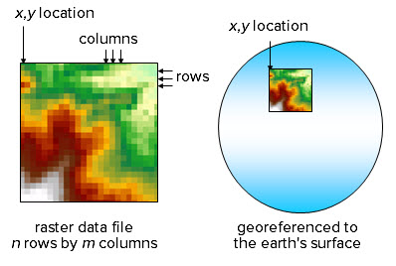
Raster data model
Source: USGS
The raster model breaks map areas into small squares known as cells or pixels
A single numeric value is stored in each cell, such as elevation

Slide 11
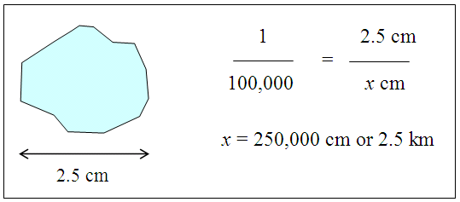
Map scale
1 cm on map = 100,000 cm on ground
Map scale is the ratio of distance on the map to distance on the ground
It is dimensionless and can be expressed in any unit: cm or inches or mm…

Slide 12
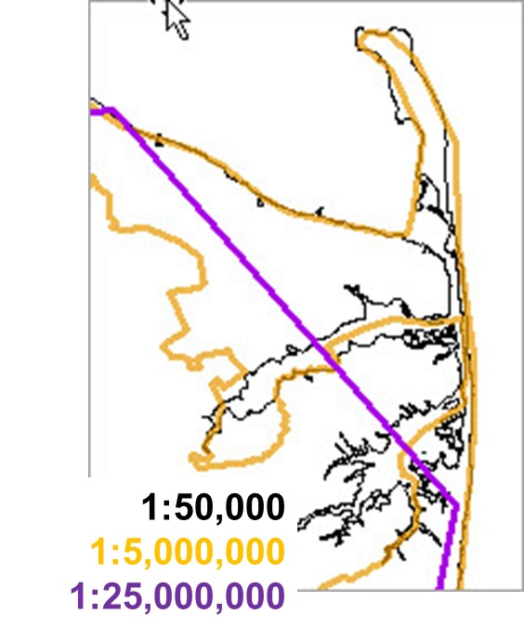
Generalization
Generalization is used to simplify map features for clear display
Small-scale maps present less detailed versions of objects.
Large-scale maps present more detailed versions.
Source scale is the scale at which data are captured
It impacts the detail and accuracy of the data set.
Source: Esri

Slide 13
GIS data and scales
GIS data may be presented at any scale
It is best not to display it at scales too different from the source scale
Larger scale maps have finer sampling distance (resolution)
Source: Esri

Slide 14
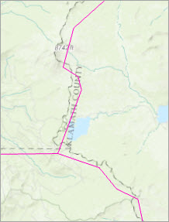
Impact of source scale
Two different data sets of the same objects may not align, especially when the source scale is different, as for these Oregon counties from two different data sources
Source: Esri

Slide 15
Data Quality
Data sets are rarely perfect
No absolute quality standard exists
Quality is defined as the fitness of a data set for a particular purpose
The same data set may be unsuitable for one use but adequate for another
A user has ethical and legal responsibility to determine whether a data set is sufficient for its intended use

Slide 16
Geometric accuracy
Is it where it says it is?
Depends on the level of error in the original source.
Additional errors may be incurred or propagated during processing.
Assessed by comparing the data to another data set with known high accuracy.
Which road is “correct”? What errors might occur in the locations of both?
Source: Google Earth and Tele Atlas

Slide 17
Thematic accuracy
How accurate are the attributes?
One might ask questions about, for example, tree crown density.
How is it measured?
How accurate are the measurements?
What are the possible sources of error?
Source: Esri
Source: GoogleEarth and TeleAtlas

Slide 18
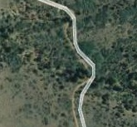
Resolution
Resolution is the sampling interval of measurements during data collection
Spatial sampling resolution.
Distance between GPS points along a road.
Size of pixel for elevation or satellite image raster.
Thematic data resolution.
How fine was the measuring scale?
Were the data classified after measurement?
Temporal data resolution.
How frequently were data sampled?
Daily, monthly, every decade?
Source: Google Earth and Tele Atlas

Slide 19
Precision
Precision has two meanings in science
It is NOT the same as accuracy!
Meaning One: the number of significant digits in a measurement
Example: a GPS unit reports locations to the nearest meter. The precision is about 1 meter.
Meaning Two: The statistical variability of a repeated measurement
Example: 20 GPS measurements at the same spot have a standard deviation of 5 meters. The precision is about ±10 meters.
Source: Google Earth and TeleAtlas

Slide 20
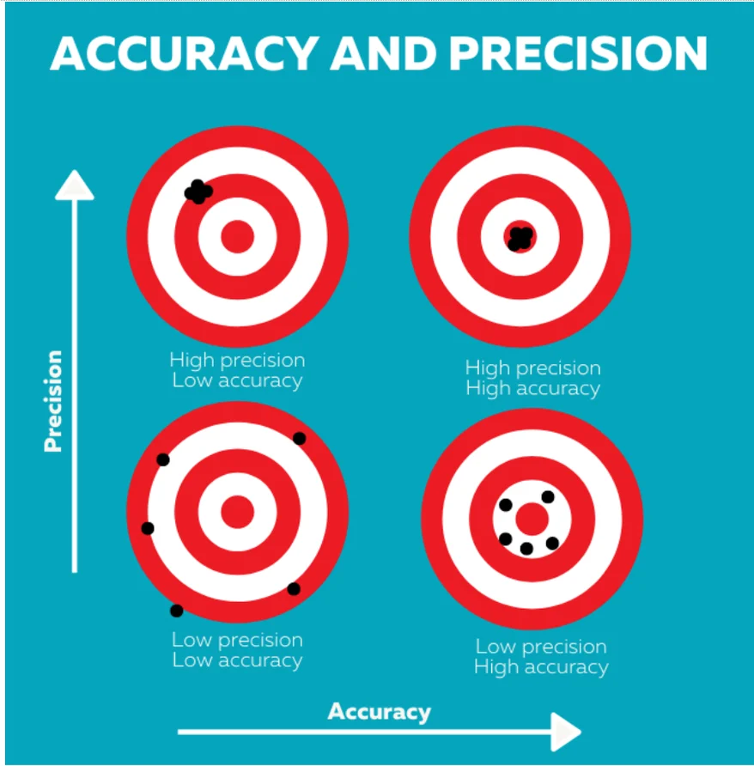
Accuracy vs Precision
Source: Accuracy, Precision, & Resolution - What Do They Mean for IAQ Sensors?

Slide 21
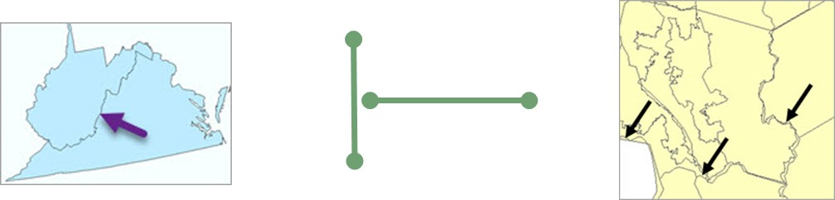
Logical consistency
Logical consistency assesses how well a data set represents real-world relationships.
Are common boundaries identical?
Do roads actually connect?
Do voting district and county boundaries align?
Source: Esri

Slide 22
Citing GIS data
Formats may vary for different agencies or companies
A good citation enables someone to find the source should they wish to obtain a copy
Citing data is a professional and ethical responsibility
Data set name (Year published) [source type]. Producer name, producer contact information. Resource URL: [Date accessed].

Slide 23
Citation examples
- Black Hills RIS Vegetation Database (2008) [downloaded file]. Black Hills National Forest, Custer, SD. URL: http://www.fs.usda.gov/main/blackhills/landmanagement/gis [August, 2010].
- Esri™ Data and Maps (2012) [DVD]. Esri™, Inc., Redlands, CA.
- National Hydrography Dataset (2015) [downloaded file]. United States Geological Survey on the National Map Viewer. URL: http://viewer.nationalmap.gov/viewer/ [July 23, 2015].
- USA Topo Maps (2009) [map service]. Esri™ on ArcGIS Online. URL: http://server.arcgisonline.com/ arcgis/services/USA_Topo_Maps/MapServer [January 1, 2012].

Slide 24
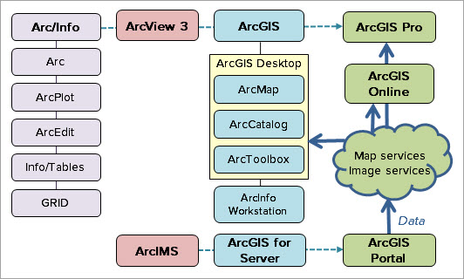
History of ArcGIS
ArcGIS has progressed from Arc/Info to the current ArcGIS Pro product with many changes along the way.

Slide 25

Evolution of GIS
GIS is evolving to take advantage of faster computers, cheaper memory, better networks, and improved user interfaces.
Expensive memory
Less disk storage
Slow networks
Mainframe or desktop
Extensive training
Data silos
Cheap memory
More disk storage
Fast networks
Desktop or mobile
Less training Data services

Slide 26
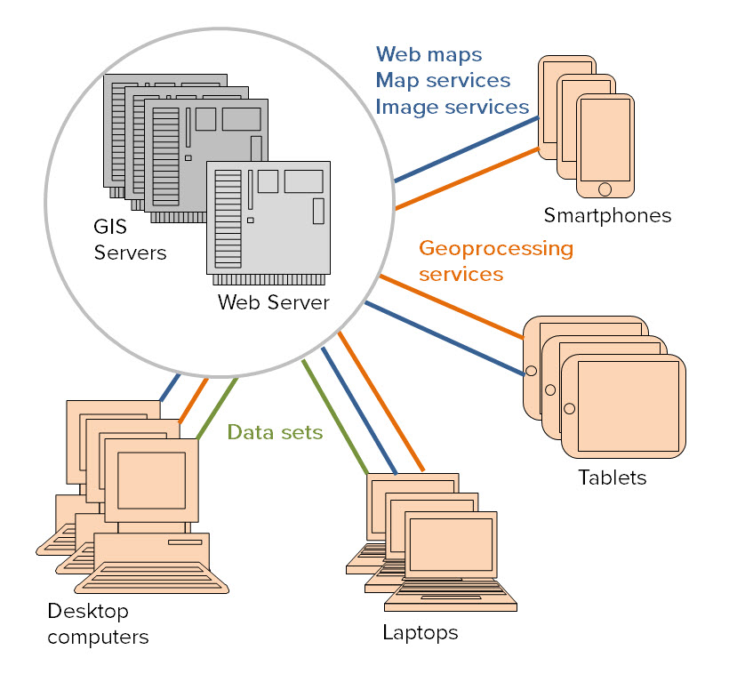
GIS Services
GIS servers provide data over the Internet
Accessible to many types of platforms
Clients only consume what is needed
Possible to do real-time updates

Slide 27
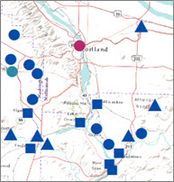
Web maps
Web maps are maps that only use GIS services
They can be shared from platform to platform
Source: Esri

Slide 28
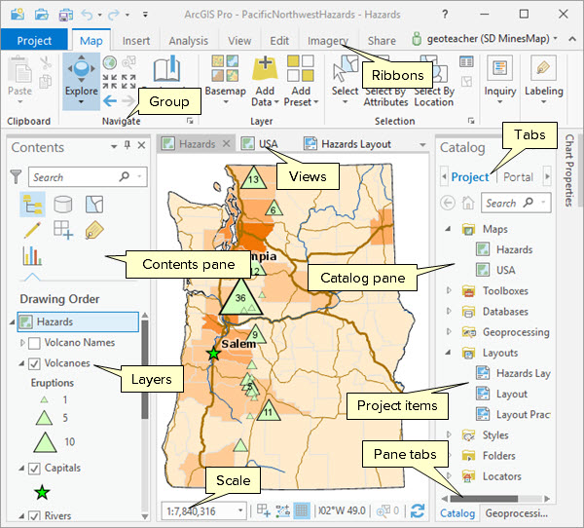
Pro GUI
Projects contain
Maps.
Tools.
Databases.
Layouts.
Styles.
Folders.
Models.
Tasks.
Locators.
Source: Esri
Notes:
ArcGIS Pro Graphical User Interface
Projects contain Maps, Tools, Databases, Layouts, Folders, Models, Tasks, and Locators.

Slide 29
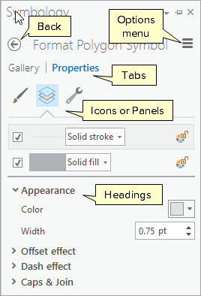
Panes
Panes contain commands and settings
Movable and stackable
It may have tabs and panels with more functions
Source: Esri

Slide 30
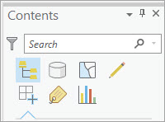
Contents pane panels
Panels (or modes) of the Contents pane
List by Drawing Order.
List by Source.
List by Selection.
List by Editing.
List by Snapping.
List by Labeling.
List by Charts.
Source: Esri

Slide 31
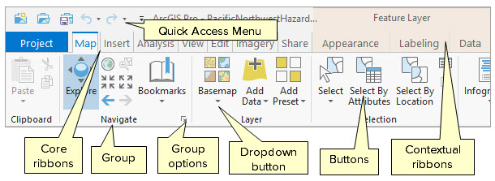
Referring to ribbon items
Each ribbon contains buttons and functions organized into logical groups
Some ribbons are always present; others appear only when appropriate
Source: Esri

Slide 32
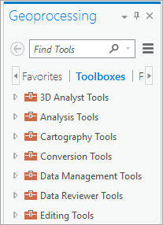
Geoprocessing pane
The geoprocessing pane contains toolboxes and tools for added functions
Extends capabilities far beyond the GUI
Source: Esri
Notes:
Graphical User Interface

Slide 33
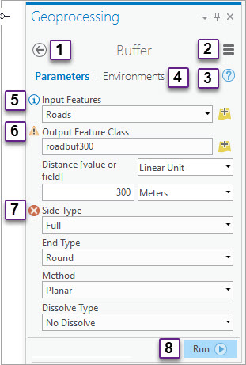
Running a tool
Icons, tabs, and menus available on tools include:
Go back to the main pane
Options menu
View Help
Environments tab
Parameter Help
Warning
Error
Run
Source: Esri

Slide 34
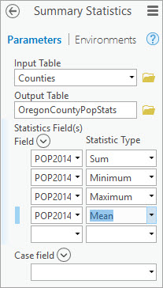
Summary statistics tool
Calculates statistics from table attributes
The user chooses fields and statistics types
Creates a new table as its output
Source: Esri

Slide 35
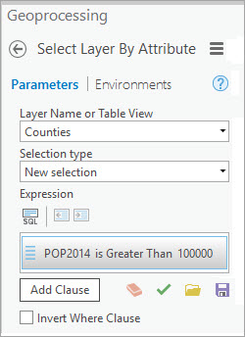
Select Layer By Attribute tool
Selects features based on values in the table
Highlights feature in the table and on the map
Source: Esri
Source: Esri

Slide 36
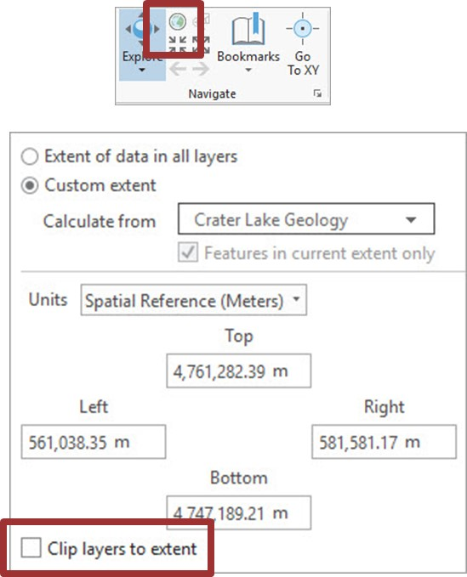
Setting a custom full map extent
The Full Extent button goes to the extent set in the map properties
Defaults to the world
You may set it to a layer or the current display extent
You can also turn off the display outside the extent (clip)
Source: Esri

Slide 37
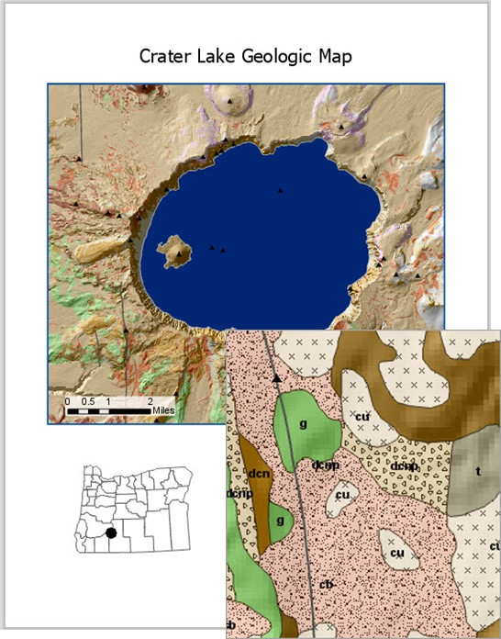
Scale ranges
Scale ranges are properties of a layer
They are set to show a layer only at the appropriate scales
Detailed symbols and labels for large-scale
Generalized symbols and labels for small scales
Source: Esri, USGS

Slide 38
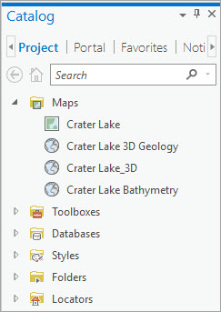
Catalog pane
The Catalog pane accesses many types of items in the project
It has four tabs
Project, for local resources.
Portal, for online resources.
Favorites, to store locations.
Notifications, to receive info about topics such as software updates.
Source: Esri

Slide 39
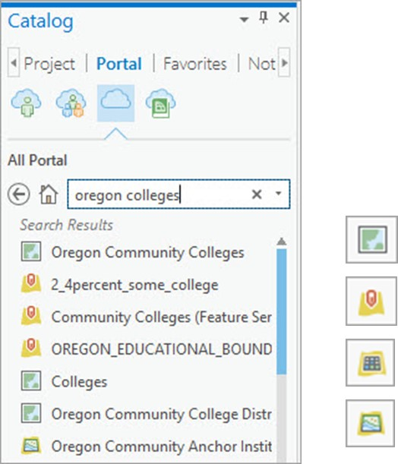
Portal resources
The Portal tab accesses ArcGIS Online content or data from other servers
There are four main types of services
web maps.
feature layers.
imagery layer.
map image layer.
Source: Esri

Slide 40

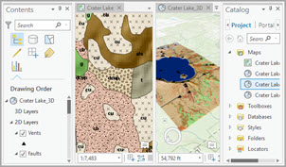
Managing views and panes
A docking icon is used to manage the placement of panes and views in the GUI
They can be positioned as
Adjacent.
Stacked.
Floating.
Source: Esri
Source: Esri

Slide 41
Layers
Source data become layers when added to a map
Layers store properties and settings for display
Each layer’s symbols and settings can be customized to appear and behave in the desired fashion.
Source: Esri

Slide 42
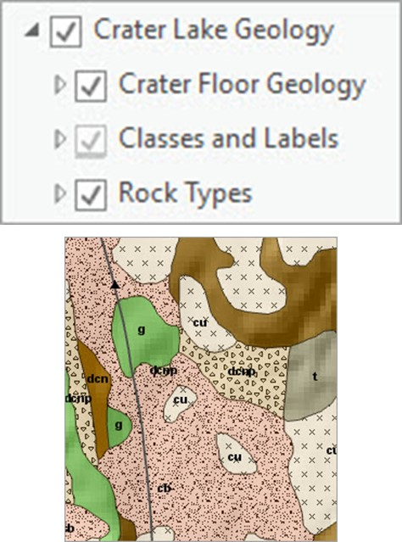
Group layers
A group layer is composed of multiple other layers
The layers may be turned on/off together or separately
It can be saved as layer files to quickly transfer display settings to new layers
Source: USGS

Slide 43
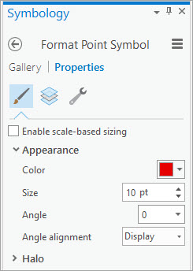
Setting symbols
The Symbology pane is used to pick and modify symbols for layers
The Gallery tab is used to choose a symbol from the available styles.
The Properties tab is used to manipulate the settings of the chosen symbol.
Source: Esri

Slide 44
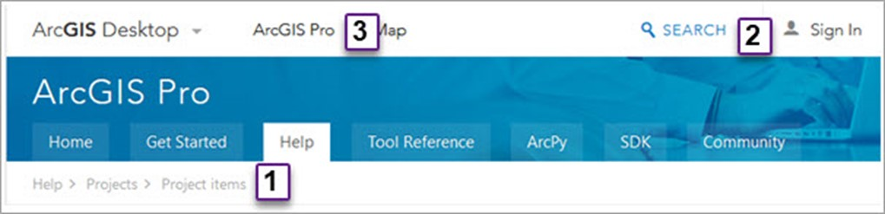
Using the Help
Source: Esri
Help is accessed through a web browser
Tabs and links on the Help bar include:
Breadcrumb trail to show the outline of topics
Search box to find a topic
Tabs to different sections of the Help

Slide 45
Course Objectives
Understanding how GIS data represent real-world features
Knowing fundamental differences between the raster and vector data models
Using and discussing map scales and source scales
Recognizing local and Internet sources of GIS data
Cultivating awareness of the types of shortcomings associated with GIS data
Learning to correctly cite data sets on a map or in a report
Learning the basics of the ArcGIS Pro interface and viewing map data

Slide 46
Chapter 1 Lab exercise
Exploring an ArcGIS Pro Project
Navigating 2D and 3D Map
Using the Help
Managing Windows
Exploring Project Resources
Working with local GIS Data
Using ArcGIS Online Content
Using Geoprocessing

Slide 47

James Ellroy, April 12, 2025, French TV, Quelle Epoque
The phrase "Geography is Destiny" is not an epigraph in one of James Ellroy's novels, but it is a concept that he frequently uses and associates with his writing, according to an essay by Dr. Alex Pavey. Ellroy himself has used the phrase in his own works and spoken about it in interviews. While the epigraph appears in Iain Sinclair's "Hackney, That Rose-Red Empire," Ellroy is often credited with its association, notes Dr. Pavey. He has used the phrase to describe how geography can influence the actions and lives of people, as well as the fictional world he creates in his books.

Slide 48



Emily Orminski, June 30, 2021
Your Zip Code is More Important than Your Genetic Code
Notes:
Emily Orminski, June 30, 2021: Your Zip Code is More Important than Your Genetic Code

